Slide 1

Data Visualization in Loan Default rate Prediction
Fu-Yuan Cheng

Slide 2
Lending Club corporation
largest peer to lending company in the world
Make money by charging borrowers an origination fee and investors a service fee.
High interest rate, High loan default rate
Notes:
Lending Club was initially launched on Facebook as one of Facebook's first applications lunched in 2006
borrowers to create unsecured personal loans between $1,000 and $40,000. The standard loan period is three years. Investors can search and browse the loan listings on Lending Club website and select loans that they want to invest in based on the information supplied about the borrower, amount of loan, loan grade, and loan purpose.
Lending Club makes money by charging borrowers an origination fee and investors a service fee.

Slide 3
Description of dataset
Dependent Variable: Loan Status
Dependent Variable:
Continuous Type:
Loan amount, Interest rate, Annual income
Categorical Type:
Term, Grade, Home ownership, address state, Purpose
Explore Shiny
https://fu-yuan.shinyapps.io/project/

Slide 4
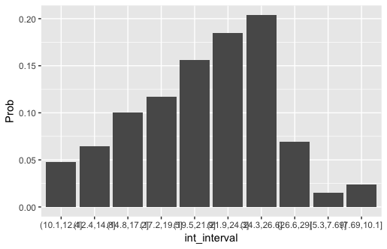

Explore the factor: DEBT CONSOLIDATION
The Determination of interest rate

Slide 5
Further Studies
Statistical Modeling
Machine learning: Modeling for Interest rate spread.

